Slide 1
Commercialisation
Notes:
People go into business to sell products and services not protect IP. Its important that IP is seen as a means of supporting competitive advantage not the main focus of business operations. As Mark & Albert have demonstrated, obtaining a patent or any type of IP protection does not mean that the protected idea is commercially valuable or can lead to competitive advantage. In fact , there are plenty of companies go out of business with an extensive IP portfolio. Bill Tai quote that IP is important if you win. Main focus should be on winning in the market. Execution and implementation is everything
Having said that IP can be a very useful commercial tool to protect and support your business model
The case studies that I will present will demonstrate how companies in Curtin's startup portfolio have used a variety of different methods to protect their market position
Quick refresher and test on who was listening. Let me have some of the key types of IP protection?

Slide 2
What is IP?
Copyright
Trademarks
Designs
Patents
Plant breeders rights
Integrated circuit designs
Trade secrets
Notes:
The importance of various kinds of protection depends on the business you’re in. Pharmaceuticals business for example is highly dependent on strong IP protection to balance the risk of investment in clinical trials. Other markets rely more heavily on copyright, designs and or trademarks .
Who thinks they may have something patentable or have filed a patent? Copyright? Design, valuable trademark don’t know?
The important point I would like to make is that no one IP protection system should be used in isolation. The strongest approach is to combine all relevant formal protection mechanisms and support protection and enforcement with the way you conduct your business.

Slide 3
What is IP?
Copyright
Trademarks
Designs
Patents
Plant breeders rights
Integrated circuit designs
Trade secrets
Business model
Notes:
Business models can be IP in their own right and designed to reinforce IP protection
Again, Important to keep in mind the business is about selling products and services. Not about filing IP protection

Slide 4
SINGLE PATENT FAMILY
No Cost
IP CAPTURE
PROV
Establishes earliest priority date
$5K - $10K
Numerous key strategic and financial decisions required to be made over several years!
_{12 months later}
$8K – $15K
PCT
_{12 months later}
_{Publication}
$15K – $75K
National Filings
National Filings
_{18 months later}
EUROPEAN APPLN
Prosecution fees along the way
CN
FR
DE
GB
US
JP
CA
AU
TW
NZ
Granted patents anywhere from 3 to 10 years later
Annual national renewal fees
Notes:
This is particularly the case in filing patents and enforcement of IP. This is expensive!
The only reason to do it is for commercial advantage
It is important to consider the timing of protection relatively to your business model and product/service roll out. Once the PCT or first national application is filed the timing is set and the clock is ticking on disclosure and your potential monopoly cover of the market. One year at the end of the patent life might be worth a lot more than the early years
Ideally you want to extend the time you have products/ services in the market and protection in place. This can be difficult particular if there are long lead times for your product of service
Options include delaying patent filing or refiling strategies
As with any business decision you need to weigh up the risks
Enforcement is also expensive. Big business incorporates enforcement cost as part of the cost of doing business. More difficult for smaller operations so its important to think creatively about how you extract value from your IP. Can it be done in ways that support protection and minimise the potential for challenge?
If you have a successful product or service, people will copy it. How do you ensure a sustainable position in the market through your mode of operation

Slide 5
SINGLE PATENT FAMILY
No Cost
IP CAPTURE
PROV
Establishes earliest priority date
$5K - $10K
$100,000!
Numerous key strategic and financial decisions required to be made over several years!
_{12 months later}
$8K – $15K
PCT
_{12 months later}
_{Publication}
$15K – $75K
National Filings
National Filings
_{18 months later}
EUROPEAN APPLN
Prosecution fees along the way
CN
FR
DE
GB
US
JP
CA
AU
TW
NZ
Granted patents anywhere from 3 to 10 years later
Annual national renewal fees
Notes:
To begin with its useful to look at a couple of different examples of how individuals and companies have extracted value from significant intellectual property
This will give us some context on thinking broadly about how we apply IP
I’ll then move to some examples closer to home

Slide 6

Notes:
Lets begin with one of the most influential technological advances of our time. The internet and the world wide web
Many of you will know that the internet was first developed by the US Dept of Defence Defence though the Advanced Research Projects Agency DARPA as a means of information sharing
The internet originally operated in a closed system
Advances by Tim Berners Lee at CERN combined the internet with hypertext . Words or phrases with special code that when clicked, sent a user to another related piece of content
In the early days there were a number of methods of enabling distribution searching and retrieving documents .
For example. The University of Minnesota also had developed a system that was an alternative method for distributing searching and retrieving documents on the internet. They charged licence fees for use of their Gopher protocol. Charging for this access created backlash from founding users of the internet who thought such protocols should be open access
Public perception can make or break product adoption and make certain business models difficult
CERN/ Berners Lee Hypertext Transfer Protocol and Hypertext markup language became the standard. Administration at CERN had initially hoped for a patent and licence fees, Berners-Lee believed instead that the World Wide Web should remain free and open, in order to spread and evolve.
Who knows how the web might have evolved if CERN or Berners Lee had taken a stronger stance on IP. Or perhaps had thought more broadly about how to generate value from the IP they had developed. For example in establishing a position in registering domain names .

Slide 7

Notes:
One argument about the early www protocols is that the IP needed to be freely available to ensure broad adoption and the value of the internet to be fully realised. If use was restricted and only a select few had access then the value proposition was significantly reduced.
Can you generate significant value without protecting IP. In some cases this is possible and in some cases it may be necessary to give away IP to create value. Does anyone know who Satoshi Nakamoto is?
Satoshi Nakamoto is the name used by the unknown person or people who developed bitcoin, authored the bitcoin white paper, created and deployed bitcoin's original reference implementation
This innovative protocol was released free to anyone who wanted to use the system. No licence or royalty paid.
In fact the method of verifying transactions that underpins blockchain and bitcoin relies on consensus verification and the more people participating in the verification the more robust the systems becomes. In this instance it was necessary to give away the software to encourage as broader uptake as possible. Some argue that it was also important that the founder remain anonymous so there was no perceived “owner” or controller of bitcoin. Given the whole point is to have a decentralised ledger that is not owned or controlled by any one group
Despite giving away IP. Satoshi Nakamoto has still been able to generate significant value in the system and reportedly holds Bitcoin to the value of $6 billion. A value that arguably could not have been reached if the original IP was help more tightly
This is a good case to demonstrate that its important to understand what business you are in when thinking about protection IP and how you are generating value

Slide 8

Notes:
Google is another good case in point
The underlying search optimisation that forms the basis of Google was originally marketed by Stanford commercialisation office to investors and others. In the early days interest was low as the technology lacked a clear path to revenue. Search results could be optimised and a more useful outcome was provided to users but were they prepared to pay for it when other search methods were available for free. It wasn’t until the advertising model or pay per clicks/links was combined with the search optimisation that a sustainable business model was generated. This established that Google was in the advertising business with a position underpinned by some clever search optimisation techniques that attracted users.
There are now plenty of current software examples of how people give away access and rights to attract users that can be monetised in different ways.
One was covered by Albert and Mark. Apple giving up owning a closed app store vs making their platform freely available to developers. They made their platform more compelling and functional and leverage development skills of a much wider cohort by doing this. Making the overall offering more valuable and locking in users.
Again, This is about understanding what business you are in. This helps decide what you should give away and what you should protect

Slide 9
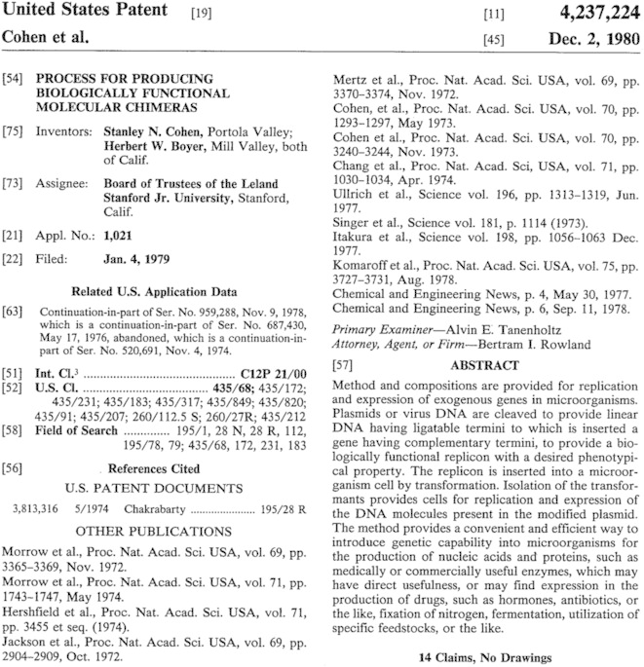
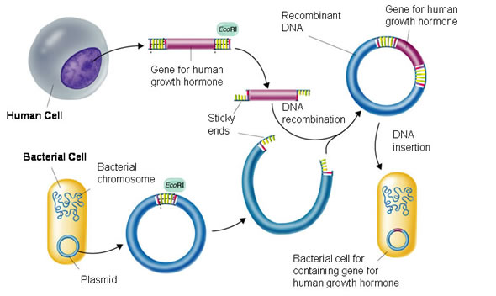
Notes:
Turning to Biotech there are examples where making IP broadly available is important to scientific progress. The patent process is sometimes criticised as inhibiting scientific progress by preventing work in particularly areas. This has somewhat been addressed in Australia by proving a research exemption to those wanting to research a topic that falls within the scope of an existing patent. This is allowed as long as the work is research and not commercial. The line can become blurry if commercial interest are involved.
The licensing activity of Stanford University on the Cohen Boyer patents is a good case study of a model adopted that allowed for broad use of a seminal technology while still enabling value extraction and minimising incentive for patents to be challenged
This set of patents covered the original invention of methods to clone genes
The IP was developed and the licensing office of Stanford only found out about the invention through a paper in Nature. In the US there is a grace period of 12 months in which patents can be validly filed after publication. Not best strategy for protection
However, the limited protection available drove a licensing strategy that encouraged early uptake by industry and minimised incentive for litigation.
Licences were offered for a low up front fee of US$10,000 and a royalty rate of 1-3%. There was also an initial incentive to sign up quickly of 5X licence fee rebate against royalties if a licence was signed up in the first 3 months of offer. The strategy was successful and 135 companies signed in the first 3 months of the offer. In total over 350 licences were signed generating in excess of US$200 million in licensing and royalty revenue

Slide 10









Notes:
That context provides some lessons in thinking about how you protect you IP
1. Understand the business you are in and how you generate value
2. Use strategies that prioritise development of sustainable value generation rather than closely holding all IP. Sometimes you might need to give something away to generate value

Slide 11

Notes:
Hearing equipment for high noise environments
Applied hearing aid technology to enterprise applications in worker safety and communication
Enabled by advances in software and hardware
Uses directional microphone array to identify voice and amplify

Slide 12
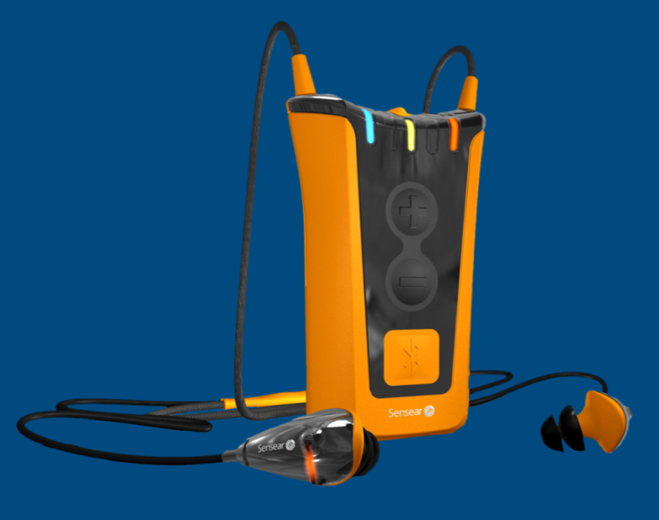
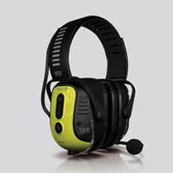
Overview
Hearing assistance for high noise environments
Amplifies voice while dampening surrounding noise
Based in the US and selling into international markets
Notes:
Prototype product/software develop in 2006. Sensear founded and seed funded
2008 First commercial product launch and recognised with international innovation awards
2010 move head office to the US
2012 London Olympics
2013 Contract with Motorola on 2-way pairing
Over 10,000 units shipped & Sales
How do you think they protected their IP?

Slide 13
Notes:
Protects active voice amplification using microphones to pick up voice and software to select out and amplify
Combines with passive noise suppression

Slide 14
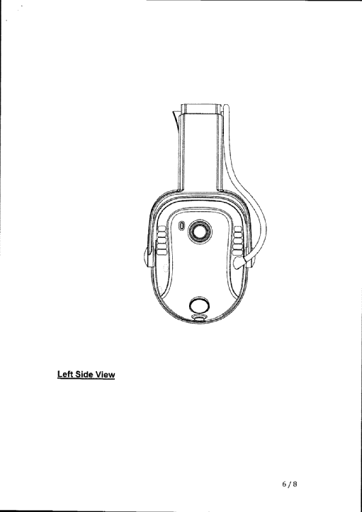
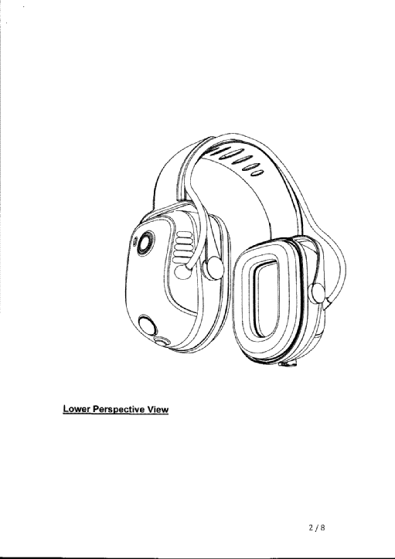
Notes:
Look and feel protected

Slide 15


Sound suppression devices, including sound suppression devices using active and/or passive sound suppression; ear muffs in the form of headphones or earphones; ear plugs; sound enhancement devices, including sound enhancement devices when combined with, or incorporated into, any of the aforestated goods; electronics modules, including electronics modules incorporating battery packs, and including electronics modules when combined with, or incorporated into, any of the aforestated goods; telecommunications devices and systems, including wireless telecommunications devices and connectors for the connection of telecommunications devices, and including telecommunications devices and systems when combined with, or incorporated into, any of the aforestated goods; software; parts, fittings and accessories for any of the aforestated goods
Notes:
Trademark in specific classes. This provides some definition and limitation on the use of the application. Allows protection of known words for specific application where the work or symbol or both might not have been used previously. Apple couldn’t be used to sell apples as considered descriptive
SENS Trademark of technology for OEM (Original equipment manufacturer) branding approach
OEM approach was developed with Motorola and others with the hope that the technology could be more broadly sold.
A key issue for small companies is market reach and overheads of sales force. How do you get your product to customers and build awareness
Large companies usually not cooperative with this approach as its considered dilutive.
Need to have power to negotiate this type of exposure
One of the most well know examples Intel That have successfully marketed thought their intel inside branding. Many small companies have this desire but few are able to gain agreement to pollute main distributer branding

Slide 16
Overview
Patent filed and granted
General trademark and technology trademark for OEM application
Software protection. Encryption, dongles, control of source code, obfuscation
Lock in of research provider
Manufacturing strategy
Notes:
Sensear and Curtin has an agreement on future developments in the field
Agreements with competitors, staff and suppliers can provide protection by limiting activities or providing favoured access. Sometimes difficult to enforce. Particularly in the case of restricting employee behaviour
Where and who you manufacture with can support IP protection. Manufactured in China but software loaded in Perth despite the expense

Slide 17
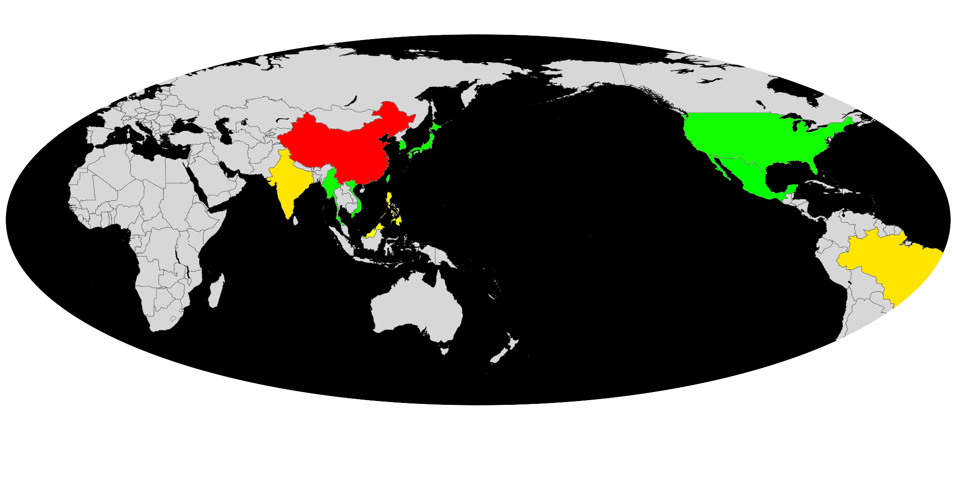
Global vs Local Manufacturing
Protect yourself
Notes:
Another example of a company employing manufacturing strategy to reinforce IP protection is Apple. They carefully consider where to manufacture and with who
From at least two perspective. Who respects IP rights?

Slide 18
Partnership Example
3M
Acbel Polytech
Alps Electric
Amphenol
AU Optronics
Avago Technologies
BYD Ltd
Catcher Technology
Cathay Tat Ming Precision
Coilcraft
Corning
Dai-Ichi Seiko
Delta Group
Diodes Inc
Dynacast
ECCO Leather
Evergreen
Fairchild Semiconductor
Flextronics
Foster Electric
Foxconn Interconnect Technology
Fujikura Ltd
Genius Electronic Optical
Goertek Inc
Henkel Corporation
Hirose Electric co
Hon Hai Precision
Infineon Technologies
Intel
Interflex Ltd
Jabil Circuit
Japan Display Inc
Knowles Corp
Kyocera Group
Laird Technologies
LG Display
LG Innotek
Linear Technologies
Luxshare
Marian Inc
Maxim Integrated
Molex
Murata Manufacturing
Nan Ya Plastics
Nichia Corp
Nippon Mektron Ltd
Nitto Denko Corp
NXP Semiconductors
Omron Precision Technology
Pegatron
Quanta Computer Inc
Qualcomm
Radiant Opto Electronics
RR Donnelley
SABIC innovative Plastics
Shenzhen Desay Battery
Shenzhen Yuto Printing
Simplo Technology Co
Solvay Specialty Polymers
Sumida Corp
Sunrex Technology Corp
Taiwan Powder Technologies
TSMC
TPK Holdings
Vishay Intertechnology Inc
Zeniya Aluminum Engineering
http://images.apple.com/supplier-responsibility/pdf/Suppliers.pdf
Notes:
What suppliers know about your product. They need to know enough to enable high quality supply but do they need to know everything?

Slide 19
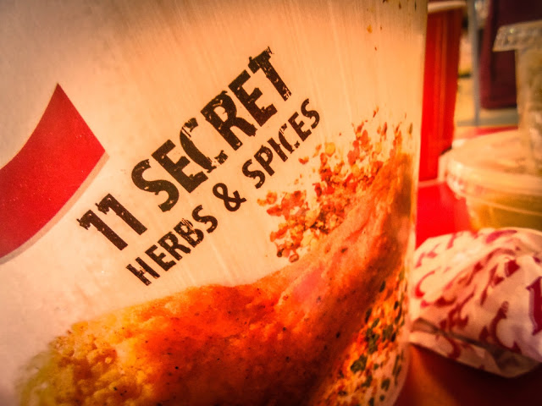
Notes:
Case of trade secrets already mentioned
Do we really think this is a secret?

Slide 20
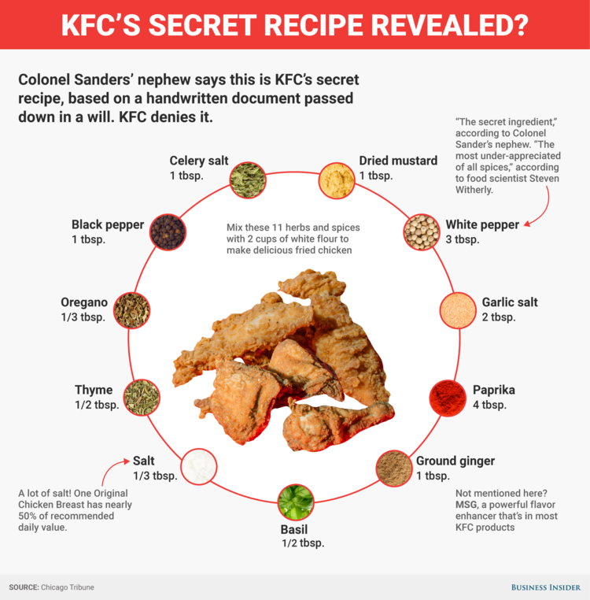
Notes:
Another way to protect is to limit supplier knowledge. Lock in suppliers with agreements on confidentiality. Use alternative suppliers. Even this doesn’t always work as in the case of conglomerates such as Goodman Fielder
Can you corner the market in at least one essential ingredient?

Slide 21

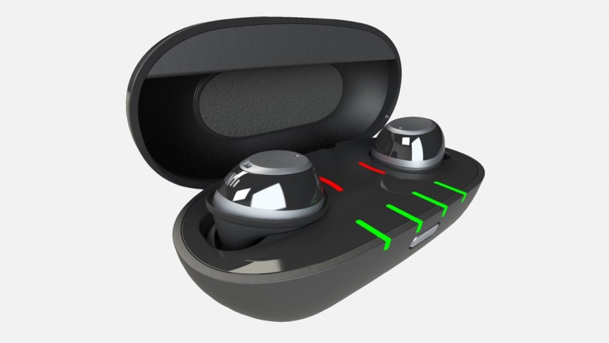
Notes:
Difficult to protect against employees leaving and using their stock in trade to develop new opportunities

Slide 22



Slide 23
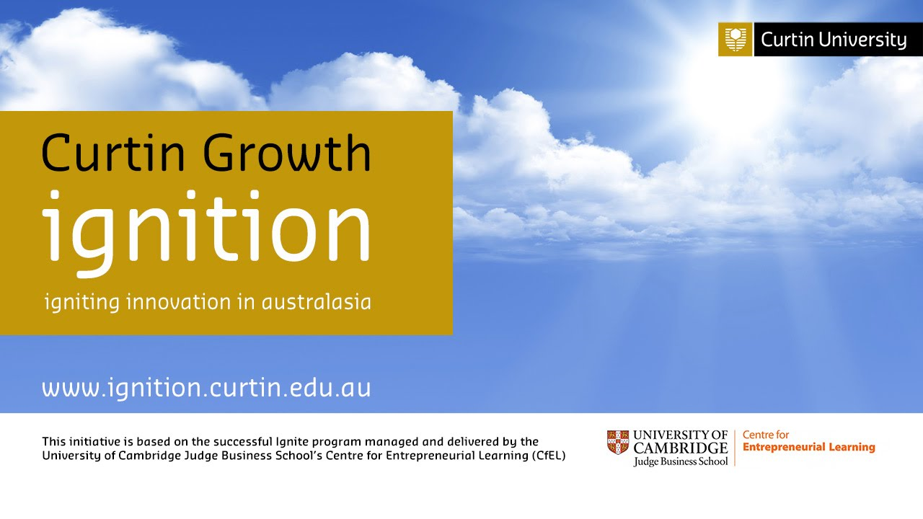
Ignition 2018 runs 26-31 August 2019
SCHOLARSHIPS AVAILABLE
20 scholarships available for staff and students
http://www.ignition.curtin.edu.au/

Slide 24
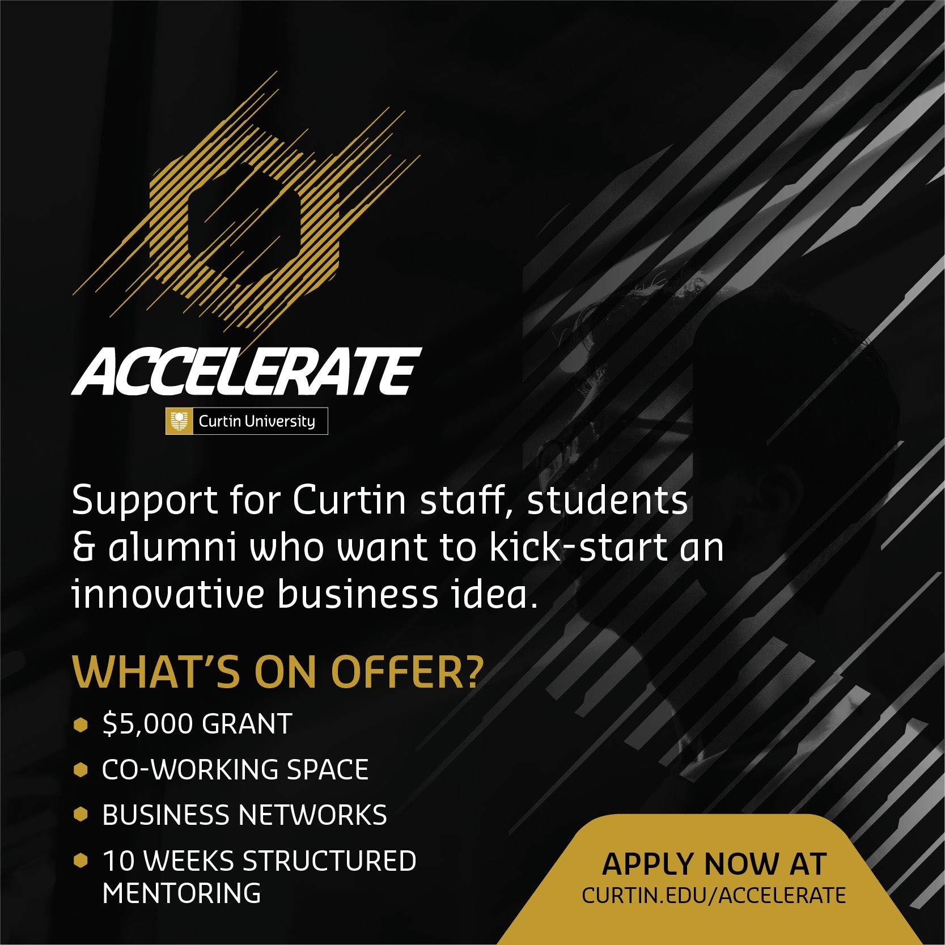

Slide 25
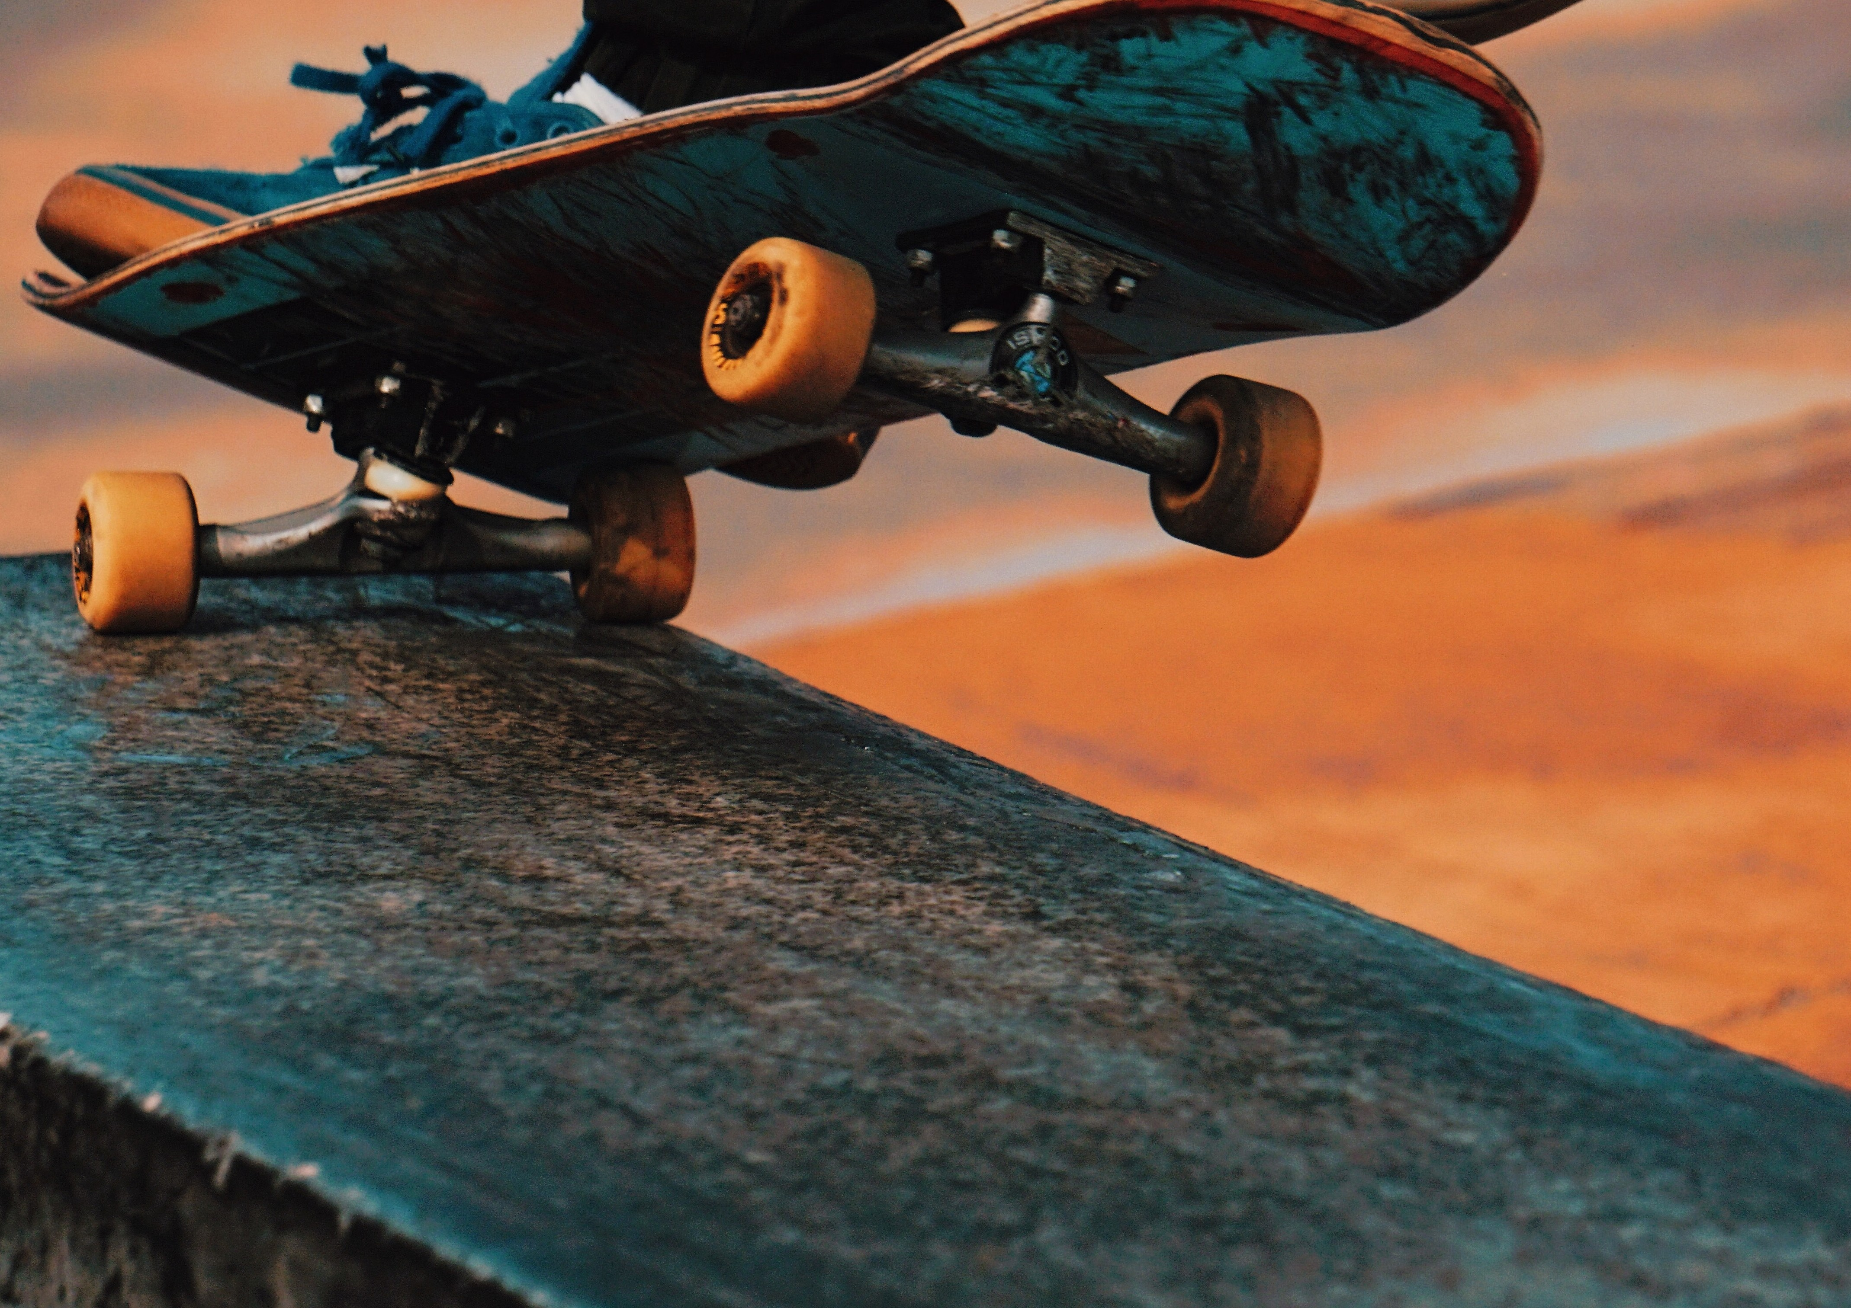






2019
westtechfest westtechfest
#WTF2018 WESTTECHFEST.COM
ENTREPRENEURS / TECH / STARTUPS / CREATIVITY / INNOVATION

